Slide 1
Ai_phase-3
Project:
Registrar of companies
Submited by:
Nithishkumar.T
BE-CSE

Slide 2
Introduction:
In this project Registrar of companies , we will analyze transaction data obtained from Kaggle to uncover meaningful patterns and associations in customers' shopping behavior. By identifying which items are frequently purchased together, we can gain valuable insights for marketing and product placement strategies.
Phase-3 Steps:
Step1:Dataset acquisition
Acquiring a dataset from a Registrar of Companies or similar government entity can involve several steps and considerations. Here's a general outline of the process:
Identify the Data Source: First, you need to identify the specific Registrar of Companies or government agency from which you want to acquire the dataset. Different countries may have different regulations and procedures for accessing such data.
Understand Data Availability: Check whether the dataset you're interested in is publicly available or if it requires a formal request or purchase. Some government agencies make certain business data freely accessible online, while others may require a formal data request or purchase.

Slide 3
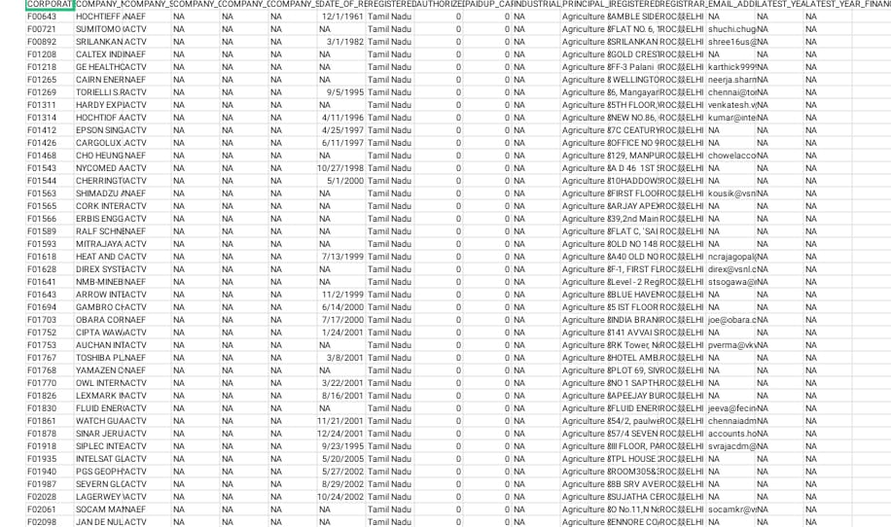

Slide 4
Step:2 project setup When setting up a project that involves data from the Registrar of Companies or a similar government entity, you'll need to follow a structured process to ensure that you have the necessary data, comply with legal and ethical requirements, and plan for data integration and analysis. Here are the key steps to set up such a project: Define Project Objectives: Clearly define the objectives of your project. What do you aim to achieve with the Registrar of Companies data? Identify the specific business or research goals. Data Requirements: Determine the specific data you need from the Registrar of Companies. This could include information about registered businesses, financial reports, ownership details, and more. Legal and Ethical Considerations: Ensure you are compliant with all relevant data protection, privacy, and copyright laws. You may need to obtain the necessary permissions or licenses to access and use the data.

Slide 5
Create a Project Folder:
Start by creating a dedicated project folder on your computer, and Naming it as "NANMUDALVAN.“
Open VS Code:
Launch Visual Studio Code and open the project folder by going to File > Open Folder.
Step3:Data loading
Loading Registrar of Companies data into your project typically involves several technical steps to get the data into a usable format for analysis or application. Here's a general outline of the data loading process:
Data Transformation:
Clean and transform the data to make it suitable for your project's needs. This may include:
Handling missing or erroneous data.
Standardizing data formats and structures.
Converting data types.
Merging or splitting datasets as necessary.
Creating new derived fields or variables.

Slide 6
Step4: Data exploration
Data exploration is a crucial step in any data analysis or data-driven project, including when working with Registrar of Companies data. Here's how to approach data exploration:
Correlation Analysis:
If applicable, conduct correlation analysis to understand relationships between variables. Use correlation matrices or scatter plots to visualize relationships between pairs of numeric variables.
Time Series Analysis (if relevant):
If the data includes a time element, conduct time series analysis to detect trends, seasonality, and cyclical patterns. This can be essential for financial or business-related datasets.
Data Distributions:
Explore the distributions of variables to understand the underlying data patterns. For example, you might assess whether the data follows a normal distribution or if it has a skewed distribution.

Slide 7
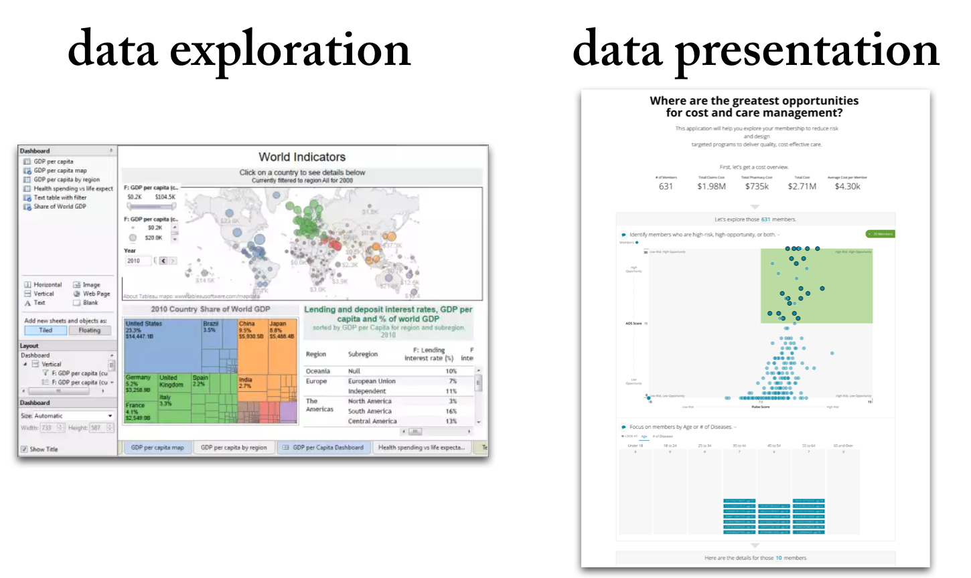

Slide 8
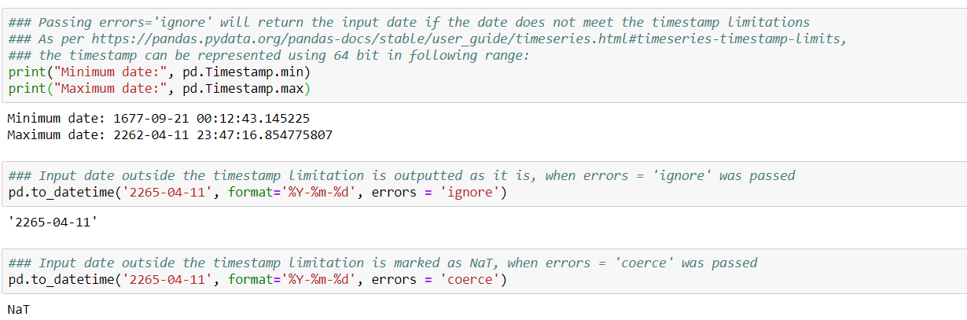
Project ideas:
Working on a project involving Registrar of Companies data can be a valuable endeavor, as it provides access to a rich source of business and corporate information. Here are some project ideas that you can consider:

Slide 9
1.Market Research and Analysis:
Use Registrar of Companies data to conduct market research and analyze industry trends. Identify emerging sectors, track the growth of businesses, and assess market saturation.
2.Business Credit Scoring:
Develop a credit scoring model that assesses the creditworthiness of businesses using financial data from the Registrar of Companies. This can be used by banks and financial institutions.
3.Competitor Analysis:
Create a tool or dashboard that allows businesses to analyze and compare themselves to their competitors in terms of financial performance, market presence, and key metrics.
4.Company Valuation:
Build a model for valuing businesses based on their financial statements and market data. This can be useful for investors and merger and acquisition activities.
5.Business Directory and Search Platform:
Create a comprehensive business directory that allows users to search for and find information about companies, including ownership details, financial data, and contact information.

Slide 10
Conclusion: The conclusion of a Registrar of Companies project serves as a summary of the project's objectives, findings, and outcomes. It is a crucial part of the project that wraps up the work, presents key takeaways, and often includes recommendations or insights. Here's how to structure a project conclusion: Remember that the conclusion should be concise and clear, providing a strong summary of the project's achievements and findings. It should leave your audience with a clear understanding of the project's impact and any steps that should follow based on the insights obtained.

